Slide 1

Employee Data Analysis using Excel
STUDENT NAME: SARAVANAN P
REGISTER NO: 312200545
DEPARTMENT: III B.com
COLLEGE: Pachaiyappa's College for men
Kanchipuram.
1
Notes:
1

Slide 2

PROJECT TITLE
EMPLOYEES SALARY ANALYSIS USING EXCEL
2

Slide 3



AGENDA
Problem Statement
Project Overview
End Users
Our Solution and Proposition
Dataset Description
Modelling Approach
Results and Discussion
Conclusion
3/21/2024 Annual Review
3

Slide 4

PROBLEM STATEMENT
The Salary Statement In Management Plays Important role, pay Employees The Correct Amount On Time, Common Payroll Problems Include Issuing Salary Slips To Their Employees Even Though Employers Must Issue Salary Slips To Their Employees, It Is Not Mandatory To Provide Printed Slips. For Employees, A Salary Slip Works As Proof Of Income.
4

Slide 5

PROJECT OVERVIEW
Employees Salary Statement Analysis To Review Though Employers Must Issue Salary Slips To Their Employees, It Is Not Mandatory To Provide Printed Slips. For Employees, A Salary Slip Works As Proof Of Income. It Provide The Detail Statements Of Expenses On Management.
5

Slide 6
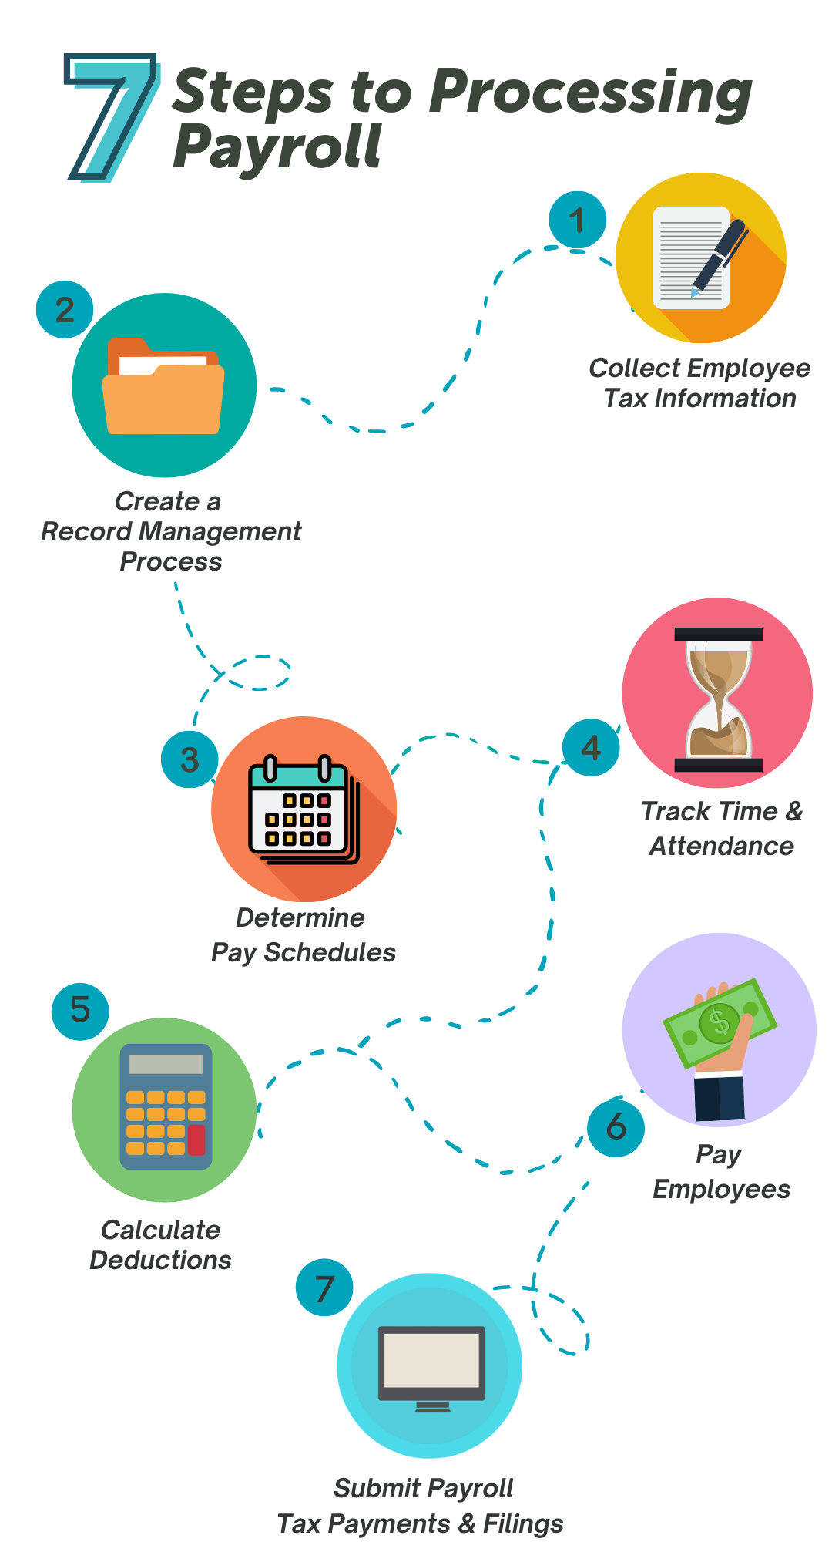

Salary process
6

Slide 7

OUR SOLUTION AND ITS VALUE PROPOSITION
CONDITIONAL FORMATTING – MISSING VALUES
FILTER-FILTER OUT MISSING VALUES
PIVOT TABLE- SUMMARY OF DATA
GRAPH- DATA VISUALISATION
7

Slide 8
Dataset Description
Employee Data Set – Kaggle
Features- 21
Considered-7
Name- Text
Provident Fund-numerical
D.A- Numerical
Gross Salary- Numerical
Net Salary- Numerical
Notes:
8

Slide 9

THE "WOW" IN OUR SOLUTION
=SALARY IFS(G15>=29182, “ VERY HIGH”,G15>=4, “HIGH”,G15>=13, “LOW”)
3/21/2024 Annual Review
9

Slide 10
MODELLING
DATA COOLLECTION
Download kaggle
Edunet dashboard- file download
FEATURES COLLECTION
1.Employees name
2.Basic salary
3.Dearness allowance
4.Travelling allowance
5.Gross salary
6.Provident fund
7.Net salary
USING PIVOT TABLE
GRAPH FOR SUMMARY
10

Slide 11
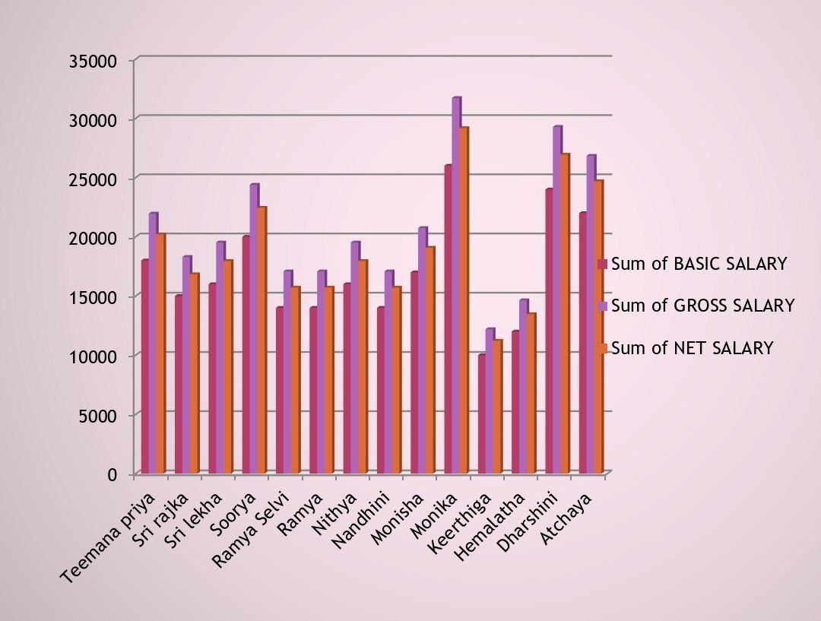
RESULTS
11

Slide 12
conclusion
The Salary Statement Provides A Clear Breakdown Of The Employee’s Total Earnings, Including Basic Pay, Allowances And Bonuses, Along Side Statutory And Other Deduction.
The Net Salary Payable Is Calculated After On Applicable Deductions.
This Statement Ensures Transparency And Accuracy In Salary Disbursement Supporting Both The Employee And Employer In Finacial Planning

